Slide 1

GeneX
Genetics made practical

Slide 2







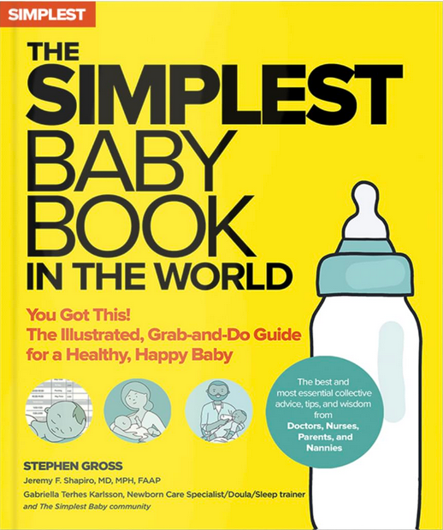










Typical guides fall short
There are many parenting books and guidelines on the market
But typical parenting guides don’t fit every child.
Especially when a genetic condition is in the picture.
Birth
2m
4m
6m
8m
10m
Notes:
Plot: 1. Books comes one by one stash on top of each other, showing there are many books in the market. 2. milestone bar appears, and those milestones get added one by one (while the voice over is saying “but the typical parenting guide don’t fit every child”. 3. (when voice over saying “specially when a genetic…” Photos of kids with genetic conditions come one by one, and a red cross appears over the books showing they are not useful anymore.
Voice Over: There are many parenting books and guidelines on the market, but typical parenting guidelines don’t fit every child, especially when genetic condition is in the picture.

Slide 3

Diagnosis… then what?
For millions of families navigating genetic or developmental conditions
Guidance is fragmented
Routines are hard to follow
and support often feels out of reach.
Notes:
Plot: These icons and text come one by one from top to bottom
Voice Over: Millions of families are navigating genetic or developmental conditions. Parents leave hospitals with a diagnosis—but no Tuesday plan.
The guidance is fragmented, routines are hard to follow, and support often feels out of reach.

Slide 4






Genex – Genetics Made Practical
That’s why we built Genex
A privacy-first app
That uses generative AI
And based on your child’s needs
Builds clear, daily, bite-sized activities
You can actually use it at home and at school
Notes:
Plot: 1. The text comes first 2. after the first line “we built genex” (said by voice over) , the logo of Genex appears. 3. when voice over saying based on your child’s needs then the icons start appearing one by one until the end.
Voice over: That’s why we built Genex! A privacy-first app that uses generative artificial intelligence and, based on your individual child’s needs and diagnosis, builds clear, daily, bite-sized activities you can actually use at home and at school.

Slide 5
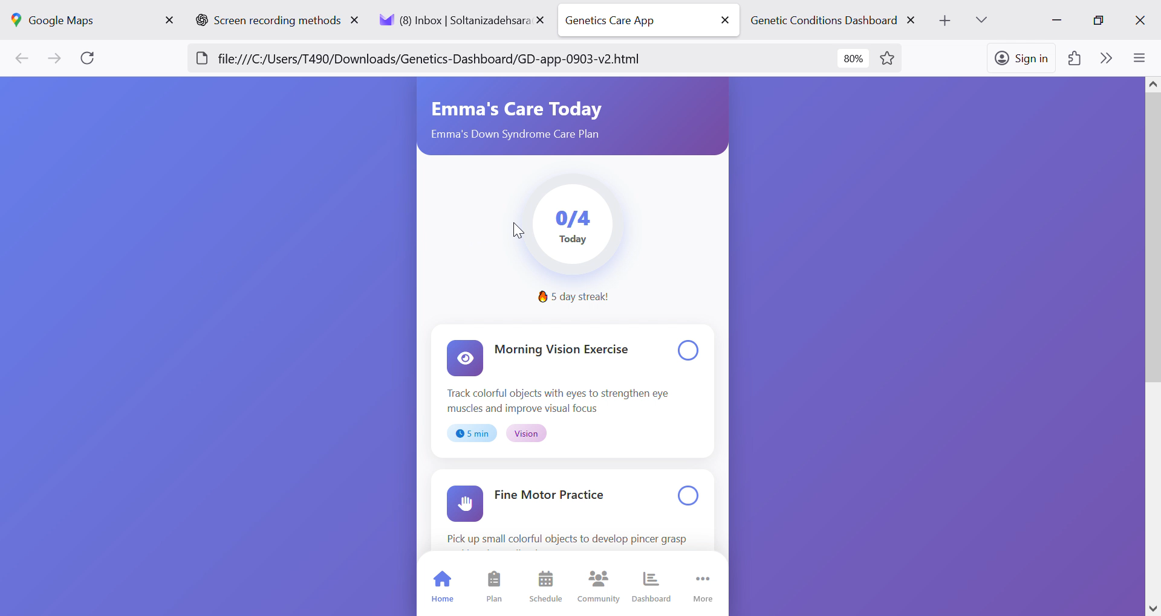
Genex – App
With curated:
5–10 minutes exercises
gentle reminders
progress tracking
community support
Helps:
families gain confidence
schools stay aligned
and children get consistent help - every day.
Notes:
Plot: The video plays and voice go over the voice over at the same time.
Voice over:

Slide 6
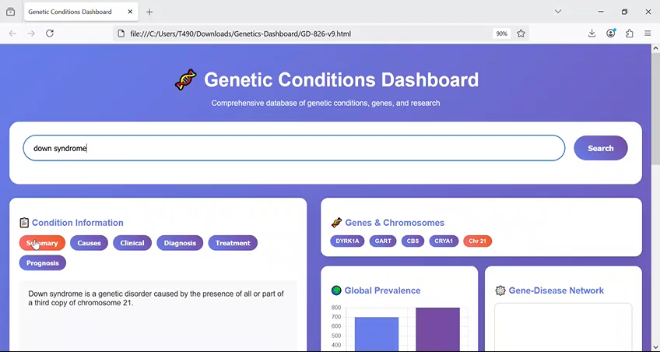
Genex – Dashboard
With:
Search and condition cards with source and confidence
At a glance visuals
Research lens including centers and top clinicians
Helps:
Families understand their child’s situation better
Know what to ask your doctor
Providers give feedback and modify suggestions
Notes:
Plot: The video plays and voice go over the voice over at the same time.
Voice over:

Slide 7
Genex – Dashboard
With:
Evidence-tagged condition panels
Knowledge graph-powered gene chips and relationships
And many more features like data exports and expert in the loop feedback
Helps:
Clinicians and providers can co-create the plan
Keep home and school on the same page
Notes:
Plot: The video plays and voice go over the voice over at the same time.
Voice over:

Slide 8
Together, we make care simpler, smarter, and supportive.
GeneX
Genetics Made Practical
Notes:
Plot: The test come one word at a time, and then Genex logo appears.
Voice over: Together we make care simpler, smarter and supportive. Genex, Genetics made practical.

Slide 9
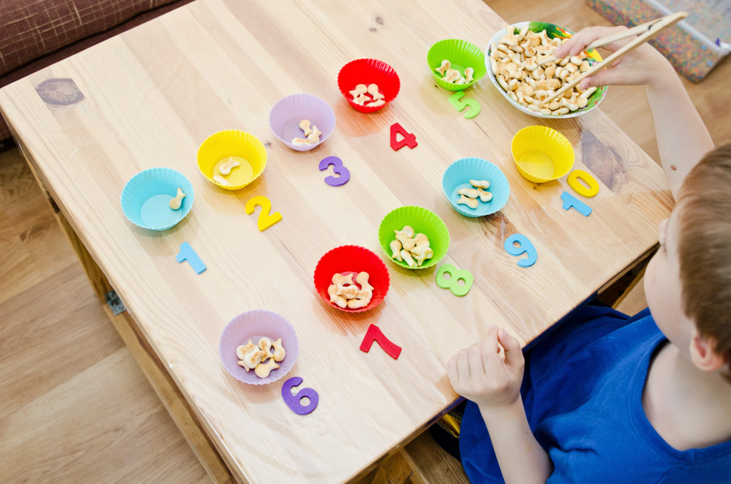

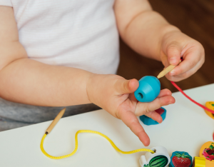
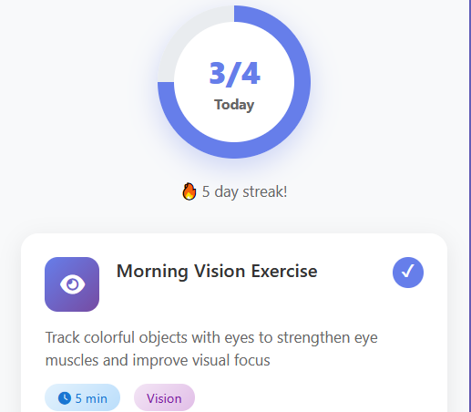

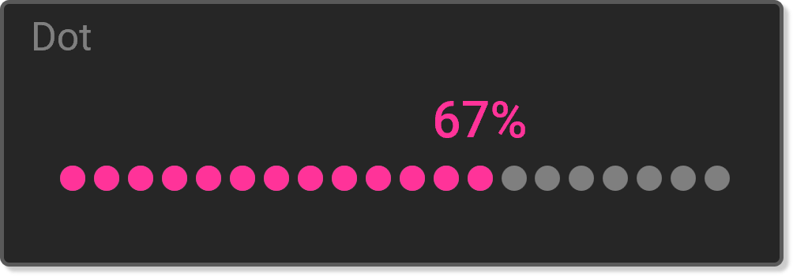
Notes:
With curated 5–10 minute exercises, reminders, progress tracking, and community support, families gain confidence, schools stay aligned, and children get consistent support — every day.

Slide 10





Notes:
"Together, we make care simpler, smarter, and supportive. GeneX — your genetics-aware care companion

